Slide 1
The Berlin Real Estate Market: What Drives Prices?
IDS702 Final Project
Moritz Wilksch

Slide 2
The Research Question
Which factors determine the price of a listing?

Slide 3


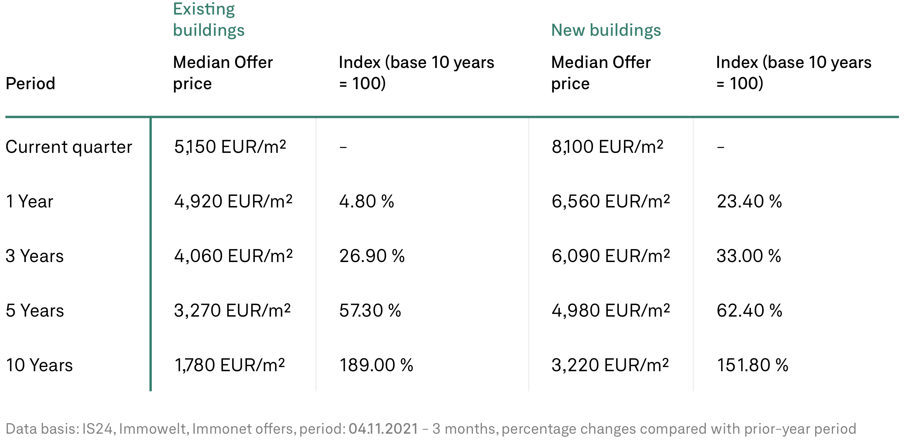
Background
The Market
The Data
Prices for buying and renting have doubled or tripled in the past 10 years [1]
Finding affordable housing is hard
Three largest online real estate marketplaces:
Scraped ~72k listings over 6 months
[1] https://guthmann.estate/en/market-report/berlin/

Slide 4
Methodology
Data Cleaning
Making missing values explicit
Outlier removal (dirty data from scrape)
Filtering: Rent prices vs. Purchase prices
EDA
Independent variables:
Object type
Private offer
Rooms
Size (sqm)
Zip code
Modeling
Hierarchical Linear Model
Varying intercepts (+slopes?) by location

Slide 5
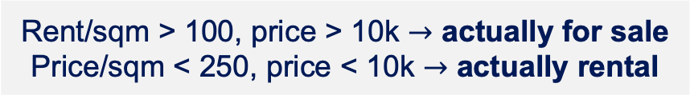
Data Cleaning
Problem
Solution
Several different object types
Focus on [shared] apartments, houses and temporary living
Implicit NAs
Make explicit for
Price = 0, sqm = 0, rooms = 0 or “k.A.”
Data entry error in square_meters
Remove outliers at the 99.9th percentile
Extreme outliers for rentals and sales
Rent/sqm > 100, price > 10k $→$ actually for sale
Price/sqm < 250, price < 10k $→$ actually rental

Slide 6
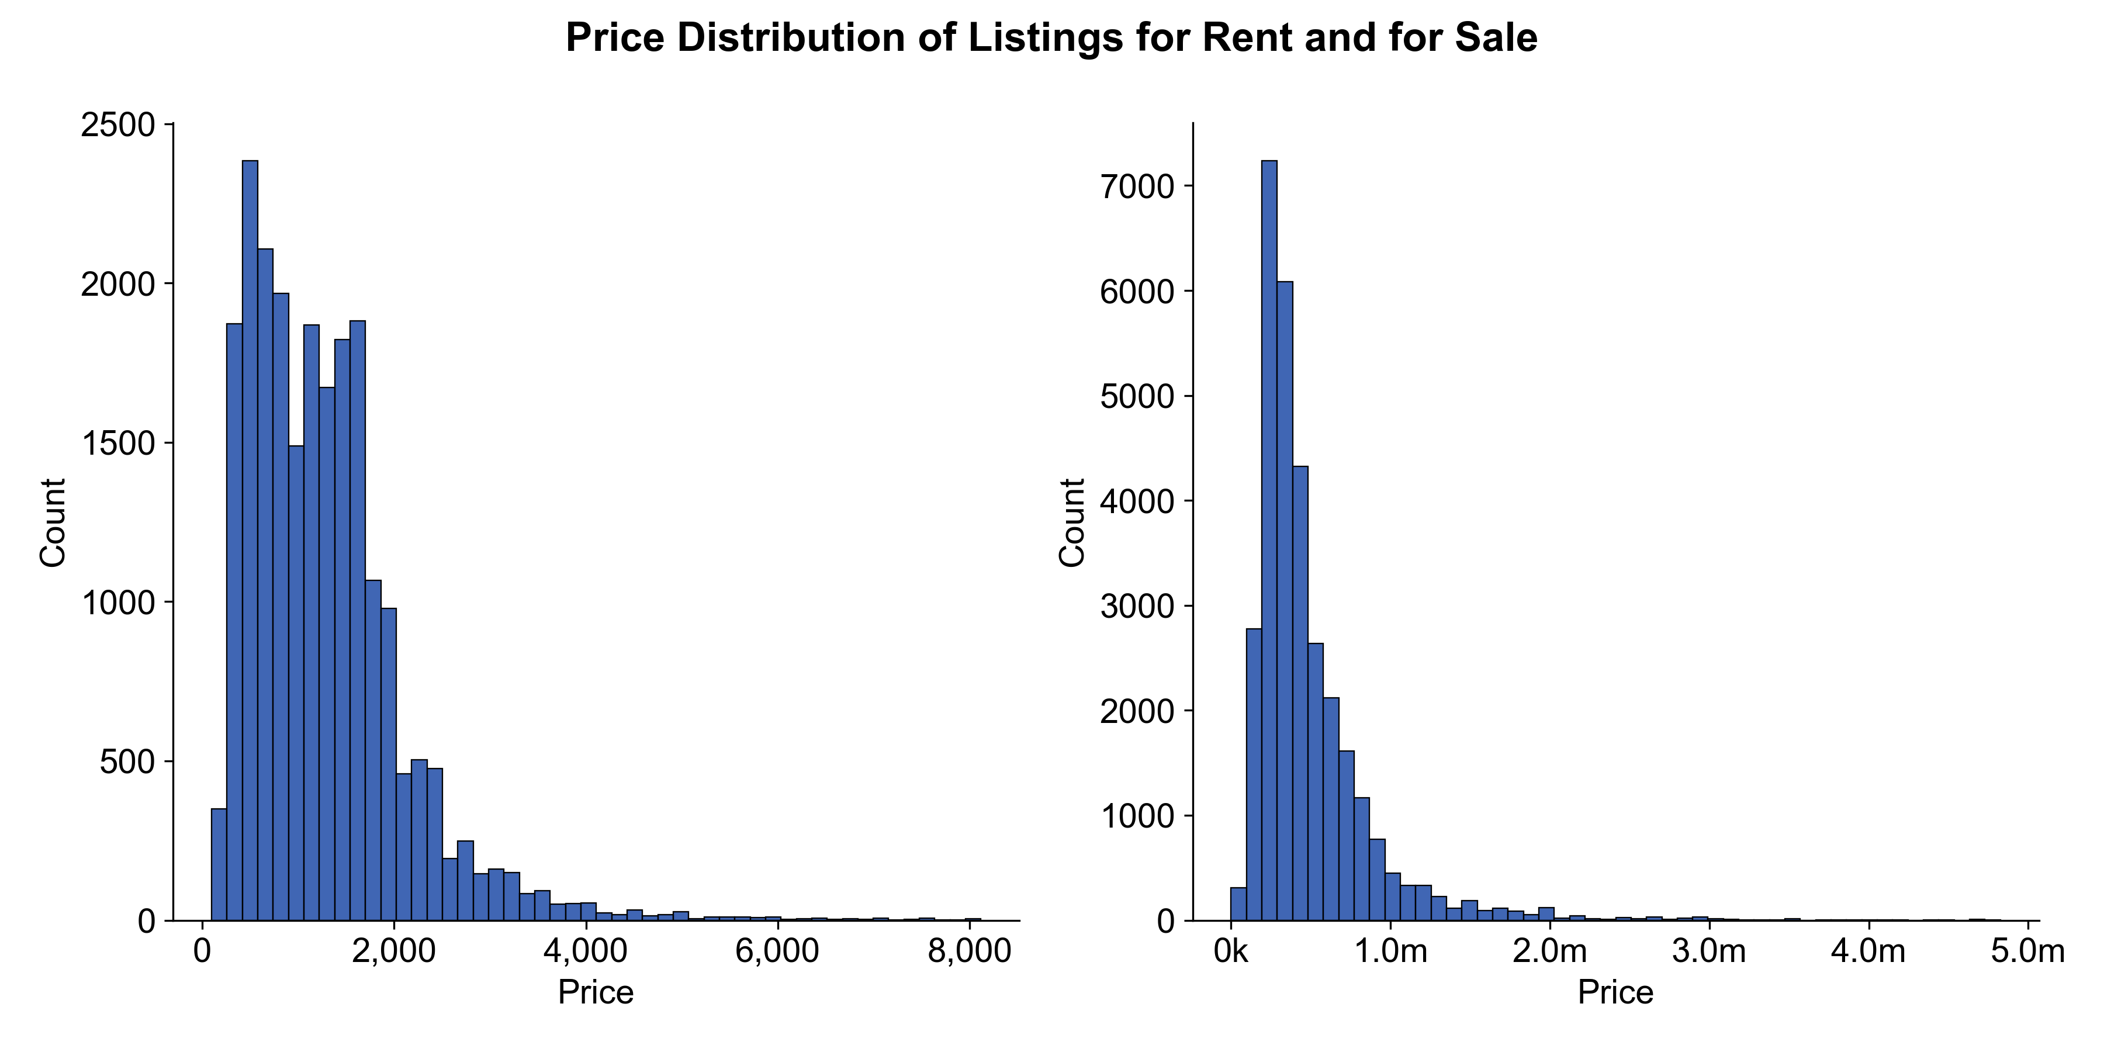
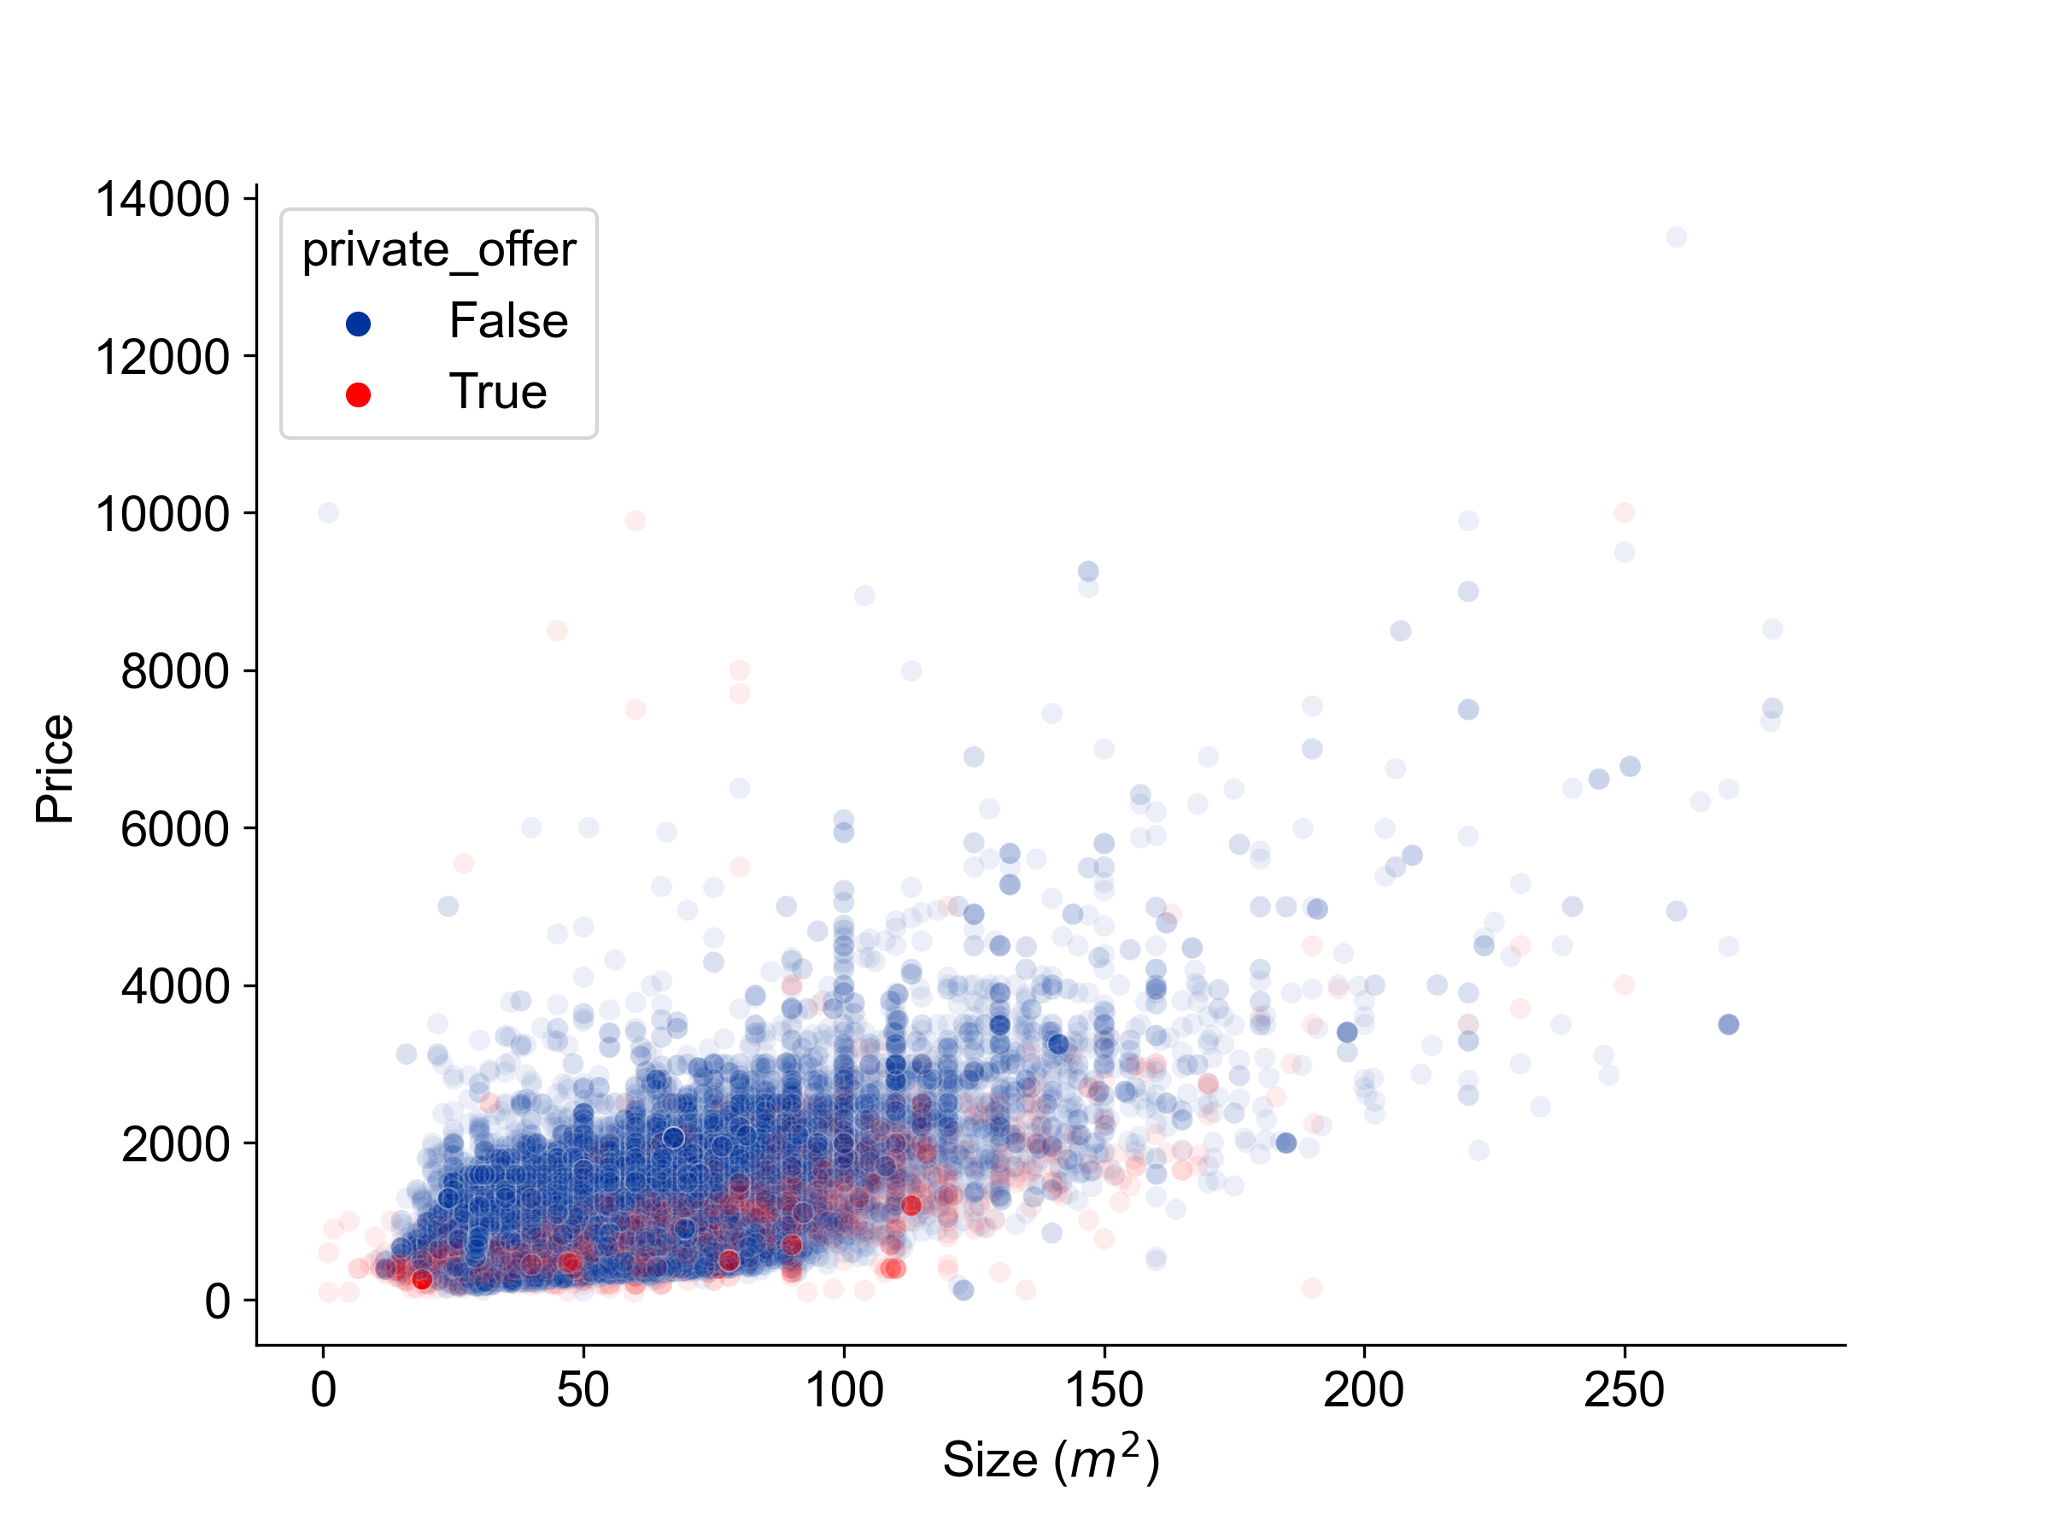
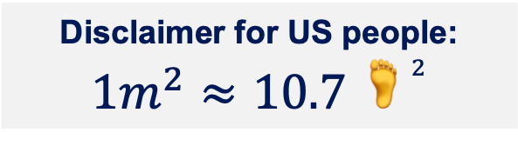
EDA
Price Distributions
Size and Price
Even after data cleaning: skewed price distributions
Somewhat linear trend
Private offers tend to have lower prices
Disclaimer for US people:
$$1m^{2}≈10.7 🦶^{2}$$

Slide 7
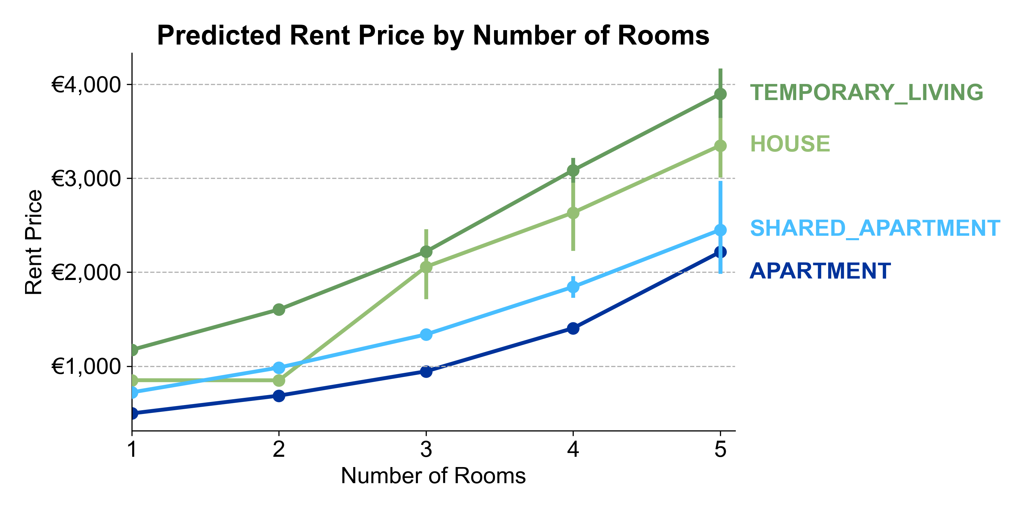
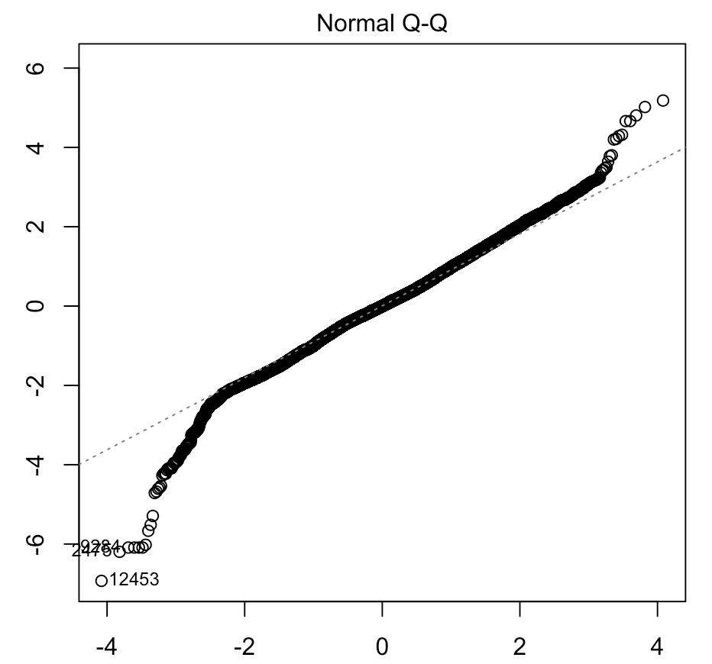
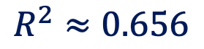
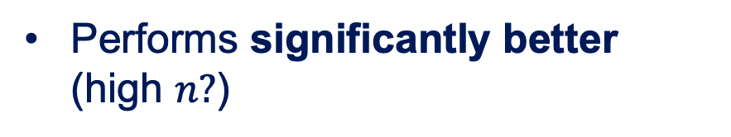

Modeling (Non-hierarchical)
EXPLORATORY
Log(price) ~ mean effects
Prediction Plot
$$R^{2}≈0.656$$
After removing 21 influential points, assumptions are satisfied…
… except for normality in the tails
Sqm $×$ Rooms Interaction
Performs significantly better (high $n?$)
☹️

Slide 8


Modeling (Hierarchical)
PRELIMINARY
Log(price) ~ mean fx + sqm $×$ rooms
Example Property
🏠
🏠
VS
object_type = APARTMENT
private_offer = FALSE
rooms = 3
square_meters = 65
zip = 13059
zip = 10117
Random Effects
420.80 €
1122.49 €

Slide 9
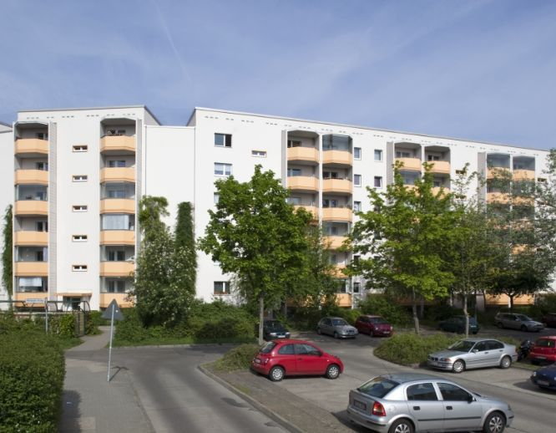

Let’s google that…
Berlin Hohenschönhausen, 13059
Berlin Mitte, 10117

Slide 10
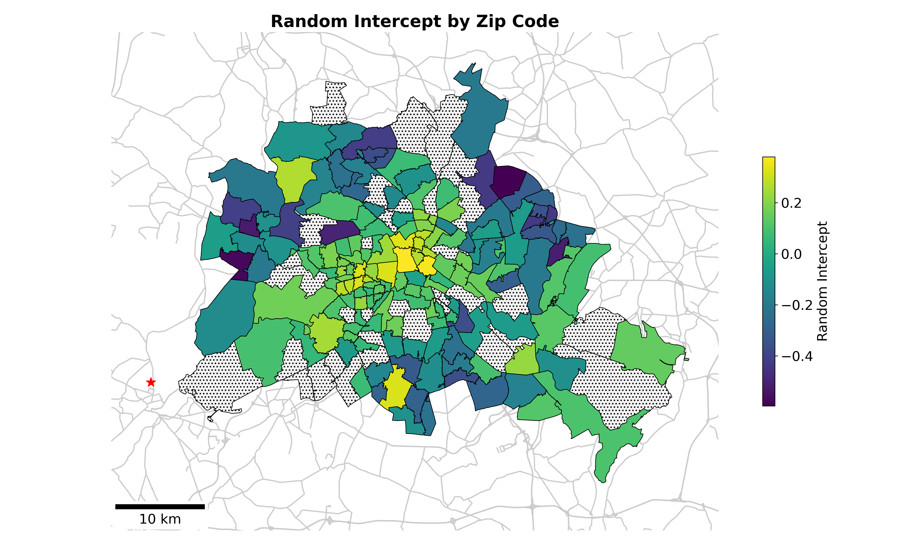

Modeling (Hierarchical)
PRELIMINARY
I live here
= non-significant random intercept

Slide 11
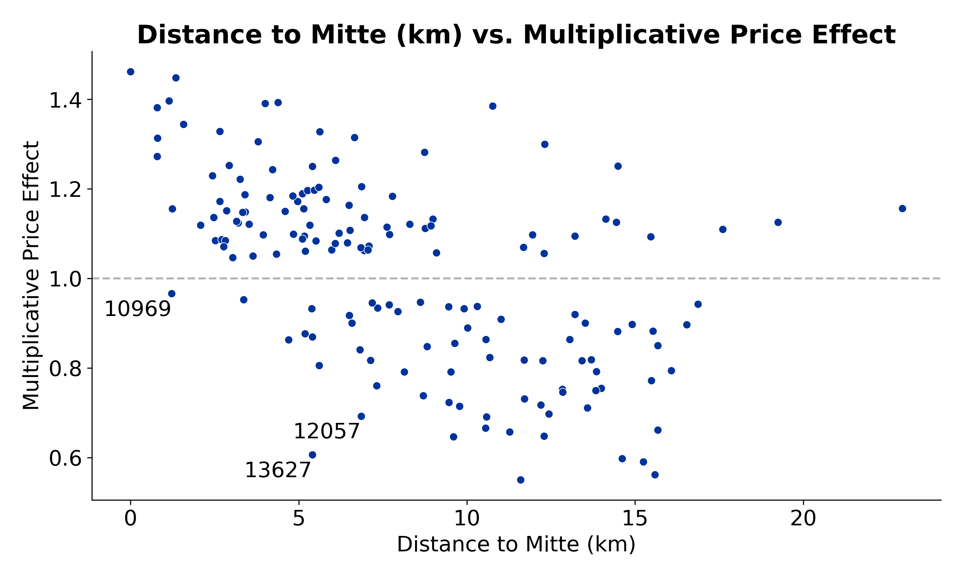
Modeling (Hierarchical)
PRELIMINARY
Expensive and far from center
Cheap & close to center

Slide 12
Wrap-Up
Conclusion
ToDo
Associated with high price
Temporary living or house
Non-private offer
4 or more rooms
Associated with low price
2-3 room Apts, although 1 room is significantly cheaper
Private offer
Move to 13059 (ugly) or 13627 (nice)
Assess assumptions for hierarchical model
Try out random slopes
Repeat analysis for properties for sale and compare results

Slide 13
This is a Title
Univariate

